Slide 1
The Effects of Acidic Environments on Xanthan-Gellan Gum Bioencapsulation
Kathryn Atherton, Matt Muskat, Alex Smith, & Holly Spiritoso

Slide 2
Bioencapsulation allows for the protection of biological products until they reach their target destination
Medium used to deliver bacteria to GI tract
Must withstand conditions of stomach in order to reach intestines
Xanthan-gellan gum combination ideal due to acidic resistance, use of calcium ions for stability
Experimental goals
Determine the type of gel which forms the best beads
Determine whether these beads protect their contents from the range of pHs found in the stomach environment
Notes:
Dr. Engelberth didn’t hate this slide, just changed the size of our experimental goals to make them more prominent. Thoughts on adding anything else?

Slide 3
Experimental Procedure & Design
Create Four Different Gel Mixtures
Test the Beads of Each Gel
Test Low Acyl Gel with E. coli
Determine E. coli Cell Density
1%xanthan
0.75%gellan high acyl
0.75% gellan (high acyl)/ 1% xanthan,
0.75% gellan (low acyl) /1% xanthan
Look at cell count under microscope
Look for trends relating pH to cell count
Note any important characteristics of each bead
Determine which bead holds shape the best and can encapsulate the E. coli
Test if the beads can protect the E. coli in the stomach
Use the average range of pH in the stomach (1.5-3.5)
Notes:
Can this be shown in less words?
Also we need to remember to discuss WHY we chose certain parts of our experimental design. Maybe those are the words we use on here rather than details of the procedure itself?
Experimental design:
looking at acidic environments like the stomach, chose pH range of 1.5-3.5 like the range the stomach typically has (source?)
Tested every .5 plus a control at 7 with four replicates each to make trends more significant
Let sit for longest possible time feasible within given lab time (1 hour, 40 minutes) to make the time as close to the time food sits in the stomach as possible (4-5 hours)

Slide 4
Xanthan-gellan gum made with low acyl gellan formed the best beads
Sample
Bead formation?
Volume/Diameter
1
1% xanthan gum
N/A
2
0.75% gellan, high acyl
0.3 mL gel filtered
3
0.75% gellan, high acyl & 1% xanthan gum
0.2 mL gel filtered
4
0.75% gellan, low acyl & 1% xanthan gum
0.1 mL gel filtered
0.26 cm diameter

Slide 5
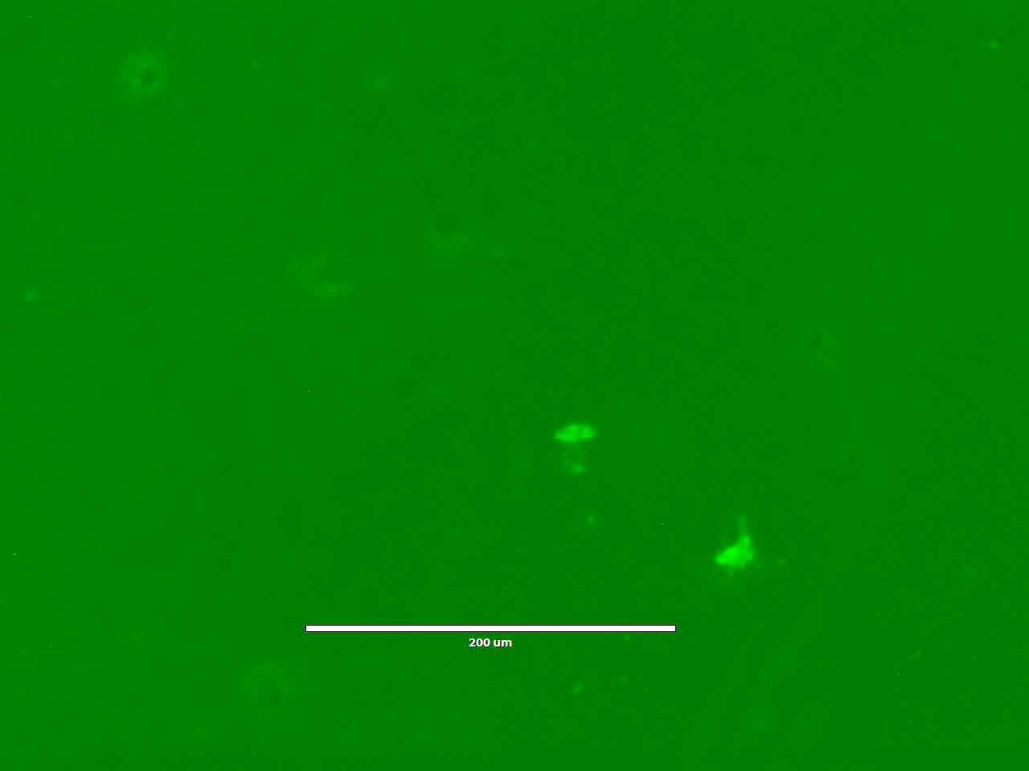
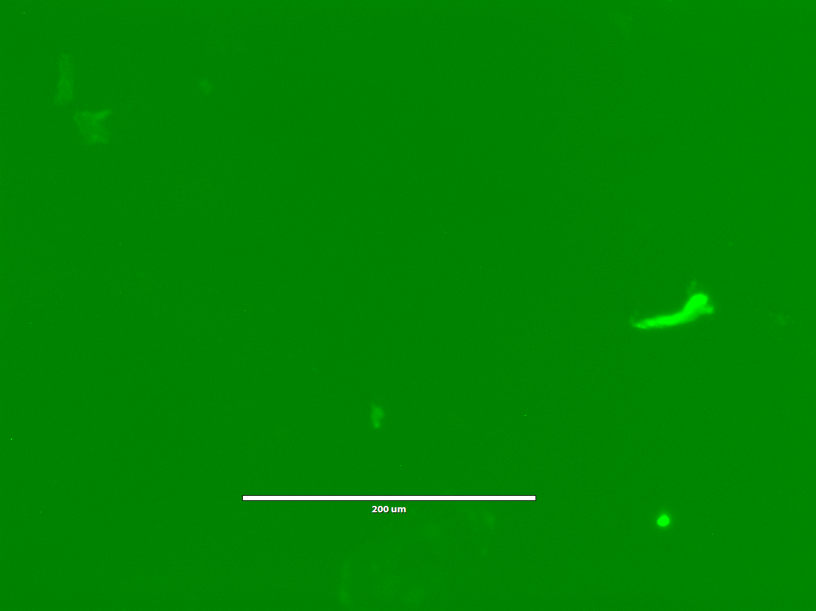
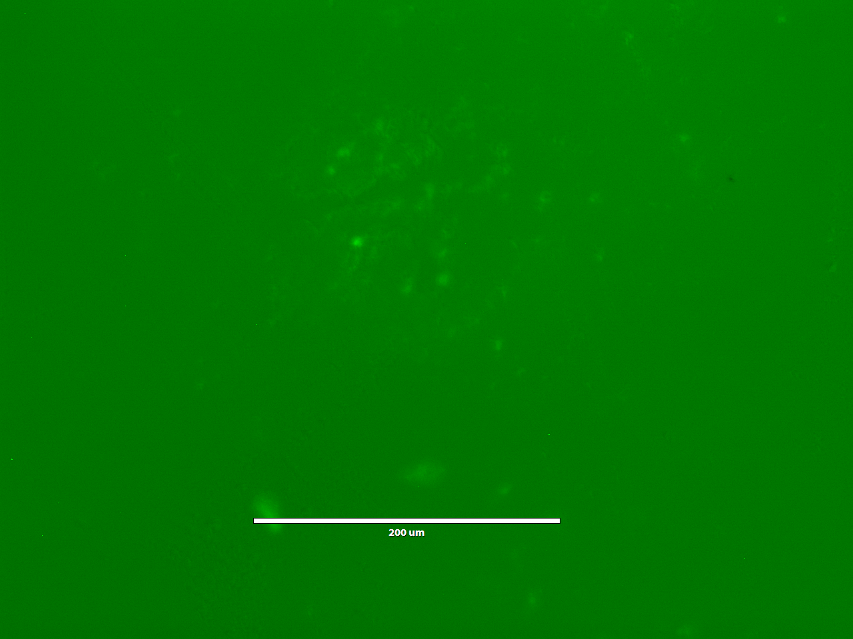
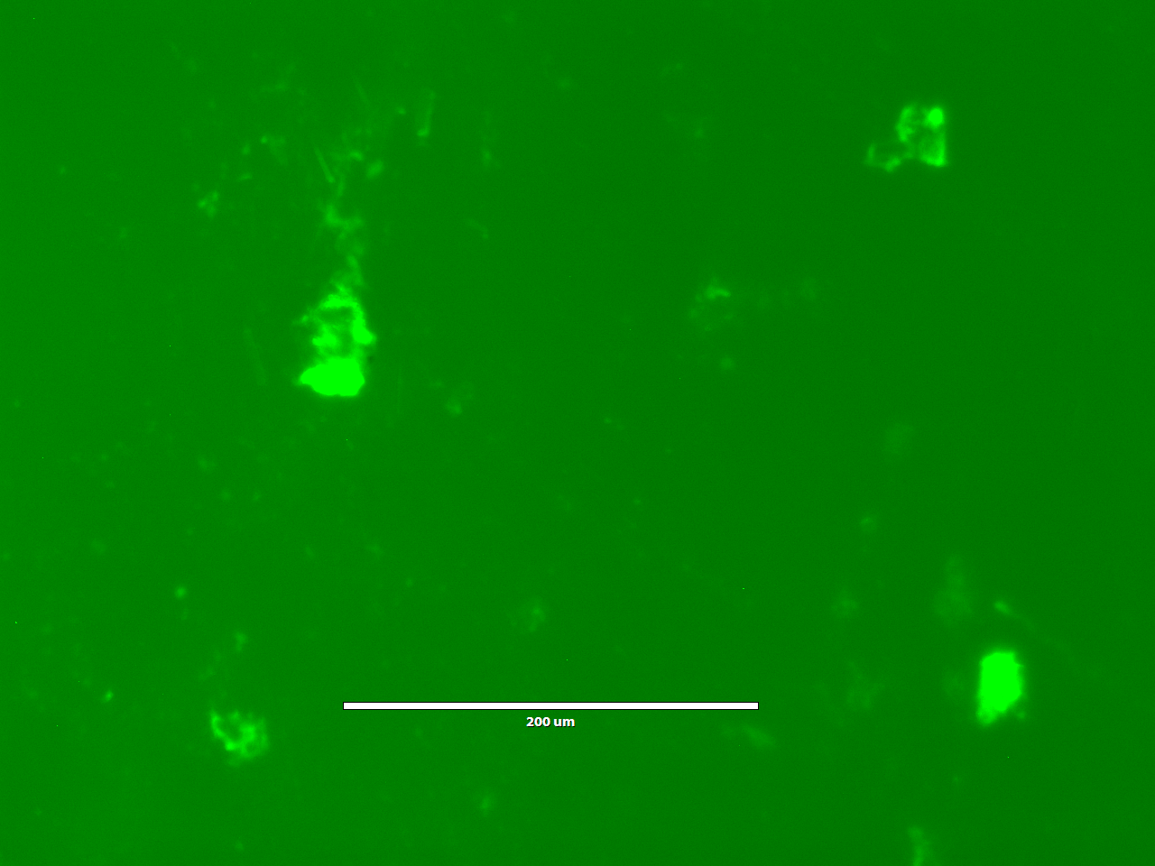
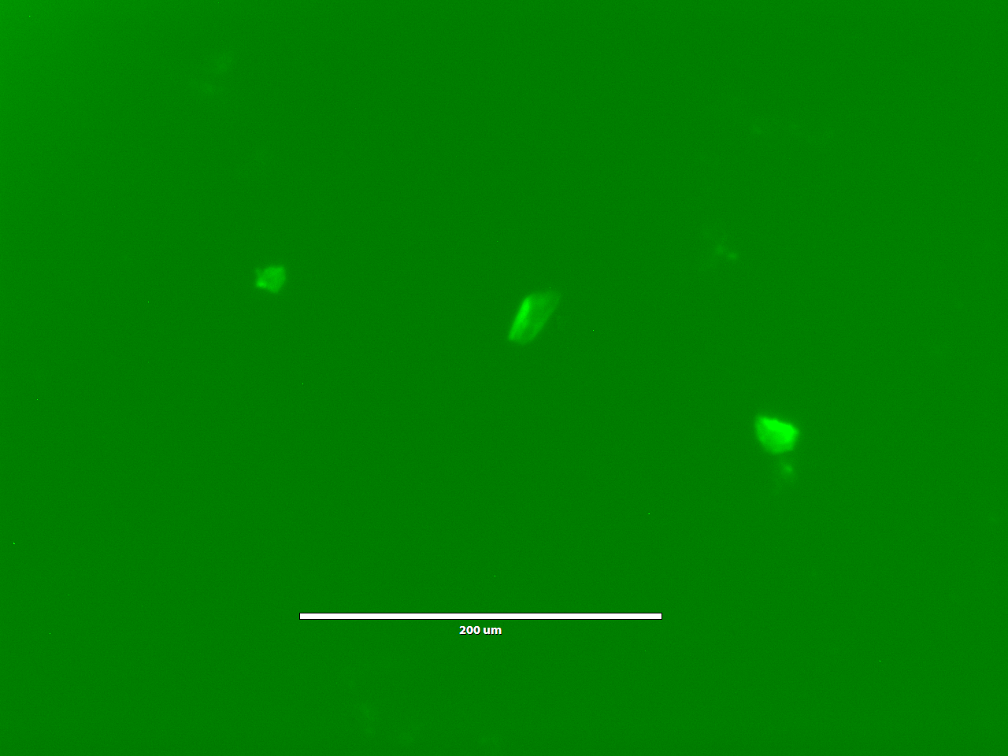
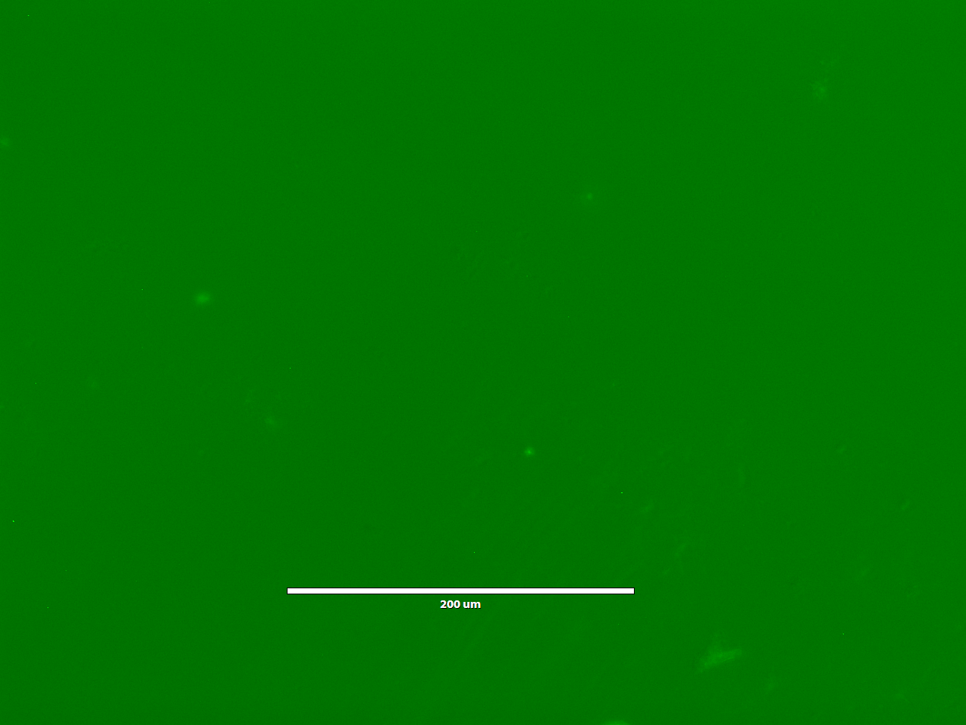
pH = 1.5
pH = 2
pH = 2.5
pH = 3
pH = 3.5
pH = 7
The low acyl xanthan-gellan encapsulation method protected the cells to some degree at each pH
Notes:
I tried to pick the most “average” picture for each pH but that’s hard so feel free to replace any of them
Do you think we should put like average cell count and blob area next to each?
Count Avg.: 0.18 0.18 0.25 0.18 0.21 0.26
Area Avg.: 1455.55 5088.90 2533.34 10144.47 1955.56 2195.55
I worry it’ll get too cluttered by adding the numbers
Yeah, that’s what I was thinking as I saw the numbers get typed in...

Slide 6
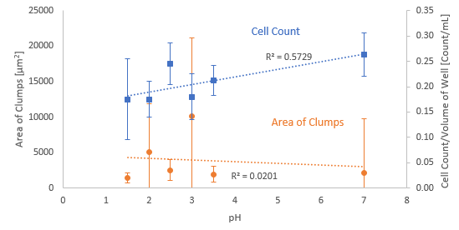
As pH increased, the number of singular cells counted increased, but the average total clump area had no significant trend
Notes:
Low acyl areated best beads (define “best” @Tao lol)
The beads produced by the low acyl were the best shape. The beads were largely uniform in size and weren’t stringy. Mentioned on slide 5
Effect of pH on bioencapsulation method
Why did they blob together at lower pHs?
So ideally we want the cells to be in a matrix and not encapsulated like a pill, yes? So that would mean that we want the environment to be on the more neutral/basic side of the stomach pH thing to make the beads more effective?
I think we also have to comment on the R^2 values of our trends to talk about statistical significance? If we decide that we should recommend the pH with the highest clumps, then we could say that since the R^2 values didn’t indicate a strong correlation between pH and … we decided to take the highest area of clumps.
What sorts of factors affect the mixing/how well dispersed the cells are?
I’d say the time of addition of the cells affects the mixing process for sure. Maybe temperature? We had to put the cells in when it was cooled so that the cells wouldn’t die, so maybe it was too cool and it was already clumping, causing the clumpy matrices?
Why are there fewer cells than expected? What does this mean for the bead?
IDK why there were so few countable cells, though. The very poor statistical significance of these results suggests kind of randomness here, but we do see a somewhat increasing trend with pH, which was what we kind of expected.

Slide 7
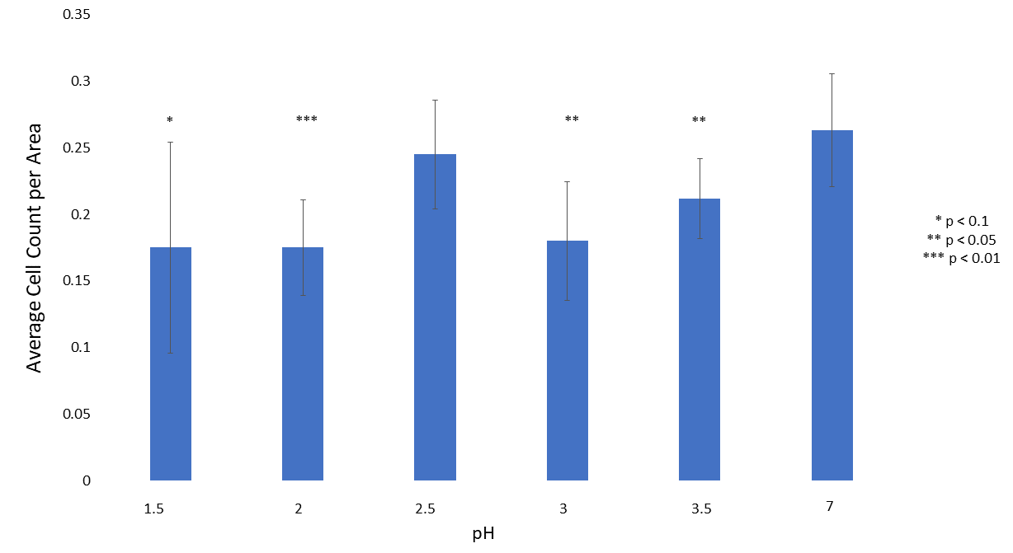
There is a significant difference in average cell count between the control and the pH except at a pH of 2.5
Notes:
Two-sample t-test

Slide 8
The 0.75% gellan (low acyl) in 1% xanthan solution shows potential for protecting and delivering cells through the G.I. tract
Conclusions & Recommendations
0.75% gellan (low acyl) / 1% xanthan created gel that held the best form
Results have very low statistical significance
Clumping of cells causes high variation in cell counts
Data suggests that bioencapsulation does not completely protect cell counts from stomach acid environments
pH effects on cell counts over the range of pHs show little change
Changes for future experimental design
Add cells at higher temperature when cooling gel
Mix cells for longer time
Notes:
I have to get ready for an RA banquet at 6. Gotta go guys, I hope this was helpful? I think we should focus primarily not on the actual trendlines we got from data, but those average cell counts compared to the control. Very nice job on that. It helps show that the encapsulation method does in fact protect cells to some extent.
It was great!! Have fun!
I agree.
We can discuss more tonight! Enjoy your banquet!
I think we need to come up with some explanations for why we saw these effects, like Samira said about the clumping because even if we don’t include it in our presentation, I feel certain they will ask about it in the questions section

Slide 9
Questions?
Notes:
Probably good to have this slide here? OK gtg.
K byeee

Slide 10
Acknowledgements & References
Banerjee, S., and S. Bhattacharya. 2012. 'Food gels: gelling process and new applications', Crit Rev Food Sci Nutr, 52: 334-46.
Burgain, J., C. Gaiani, M. Linder, and J. Scher. 2011. 'Encapsulation of probiotic living cells: From laboratory scale to industrial applications', Journal of Food Engineering, 104: 467-83.
Jaroch, D., E. McLamore, W. Zhang, J. Shi, J. Garland, M. K. Banks, D. M. Porterfield, and J. L. Rickus. 2011. 'Cell-mediated deposition of porous silica on bacterial biofilms', Biotechnol Bioeng, 108: 2249-60.
"KelcoGel gellan gum book." In. 2007. edited by CPKelco.
Sun, W., & Griffiths, M. W. (2000). Survival of bifidobacteria in yogurt and simulated gastric juice following immobilization in gellan–xanthan beads. International Journal of Food Microbiology,61(1), 17-25. doi:10.1016/s0168-1605(00)00327-5

